Slide 1
Robotic Vine - Design and Analysis for Search and Rescue Operations
Mentor :
Mrs NIKITA M GAWAI
Group 25

Slide 2
Group 25
Tejal Wagh | 111810091
Mihir Tipre | 111810096
Paras Raina | 111810102
Tarun Ponala | 111810141

Slide 3
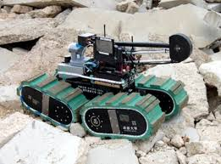
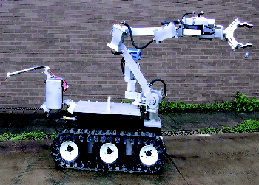
Requirement
Existing Tech is bulky and slow
Soft robotics is an emerging field
Our robot can outperform traditional robots in almost all aspects

Slide 4
AIM
To design and analyse soft everting vine robot and use them to replace traditional robots in search and rescue operations

Slide 5
Objectives
To perform literature survey ✓
Material testing and selection of material ✓
Ansys Simulation for pressure analysis ✓
MATLAB simulation of robot
Prototyping of Robot

Slide 6
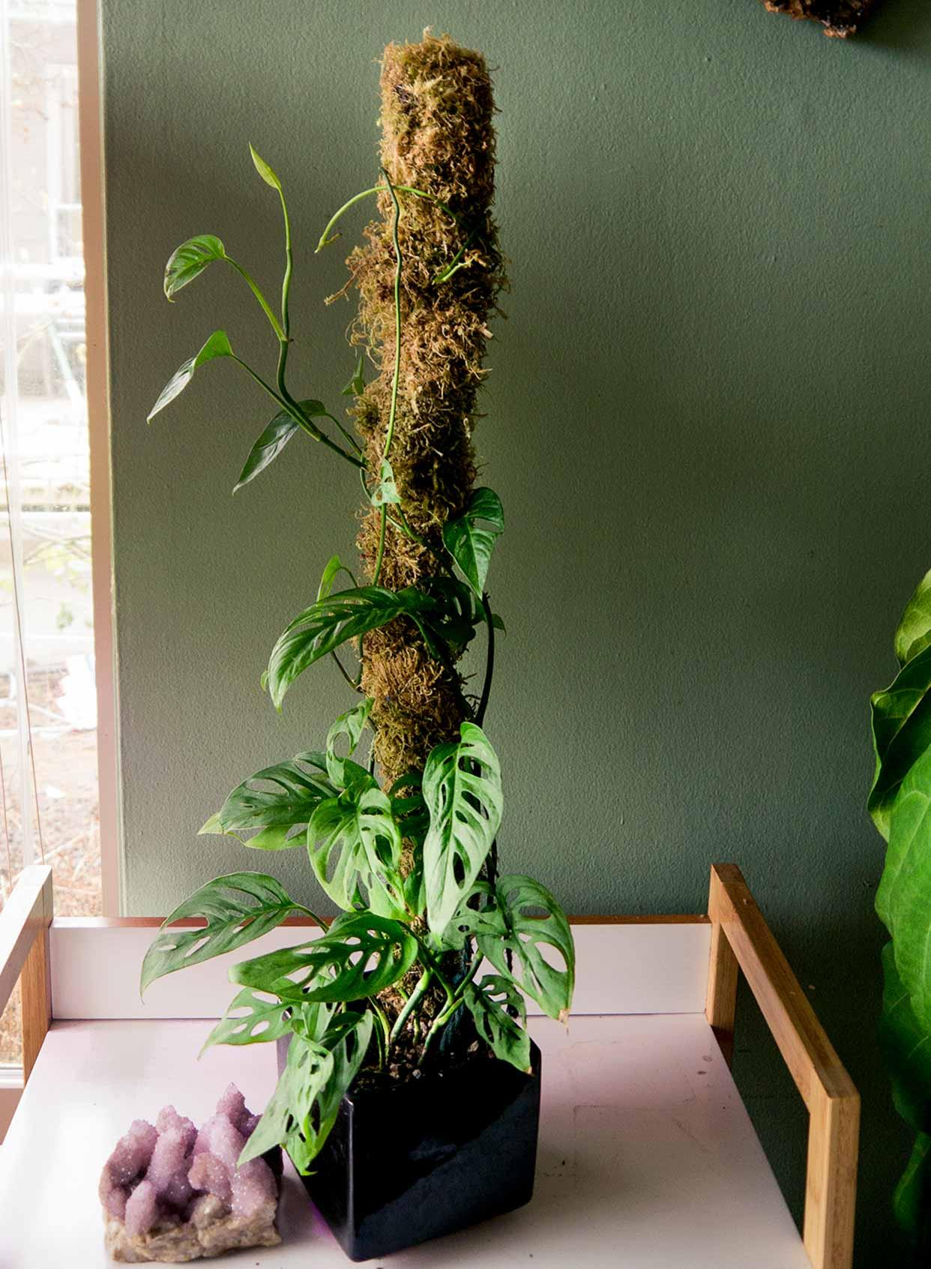
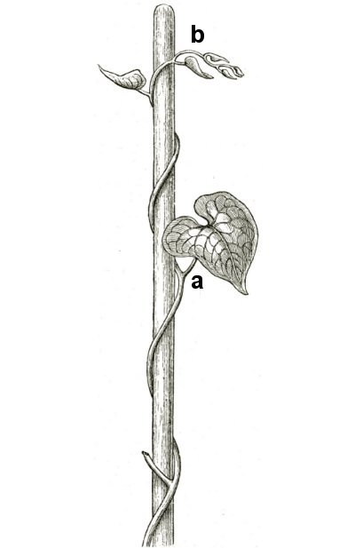
Inspiration
Vines for example Grape vines grow from tip and elongate, while their roots remain fixed in the ground. Our robot is inspired from vines and follows a similar tip growth model

Slide 7
About vine robots :
The Vine Robot is a vine-like, growing soft robot that can be used to navigate cluttered environments. Traditionally, biomimetic robots draw inspiration from the animal kingdom and use locomotion to achieve mobility.
The vine robot, however, was inspired by members of the plant kingdom. Much like the common ivy, it is able to achieve mobility through growth rather than locomotion.
How does it work?
The vine robot is grounded through a base station, where the unused length of robot material is stored until required. Once a fluid is used to pressurize the base, the inner chamber pressure enables forward growth through lengthening at the tip. It is important to note that unlike snakes and earthworms, the robot does not slide as it grows; it has no movement relative to its surroundings.
As a result, it is able to move through the environment with ease, especially in constrained environments where friction would have normally hindered movement in a sliding robot. The vine robot can also be steered through reversible or non-reversible means as it grows. This allows it to navigate environments with obstacles and reach its target location.

Slide 8
What are vine robots?
Vine Robots are soft continuum robots designed with low-cost fabrication and for the navigation of difficult environments. Unlike traditional robots, which move through surface contact to walk or run, the vine robot relies on growth for movement. Much like a vine and other plants, the robot has a grounded root, or “base,” and can continually grow as it expands to add material at its tip.
Vine robots can be easily assembled and programmed by novices while also having the option to perform complex tasks. They allow users to either pre-program or control the growing robot in real-time as it navigates the environment. The robot can:
Traverse rough, sticky, and sharp terrain
Grow 100 times its original length
Enter gaps one-fourth its original size
Climb vertically
Transport fluids

Slide 9
An Example of Vine Robots in Pushing Weights
Applications used - in a collapsed building, in a car crash, in an earthquake.
This robot can potentially lift a large object on someone who is trapped, by applying huge forces with very soft, cheap and lightweight material.
We could deploy a 100 of them into a collapsed building with a sensor and if some of them finds somebody in an uncomfortable situation, it would immediately perform the tasks thereby saving a life.
These robots can be deployed in search and rescue operations by attaching sensors like a camera on to the front.

Slide 10
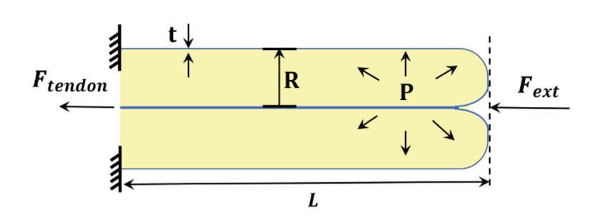
(P*π*R²) = F_{ext} - F_{tendon}
For max Force , F_{tendon} =0
Fmax = P*π*R²= 20684.272 x π x (10.16/100)^2 = 670.776 N
Fmin = Pmin x π x R=13789.515 x π x (10.16/100)^2 = 447.184 N
Force Ex Range ( 447.184 - 670.776 N)

Slide 11
Proposed Specifications
Working Pressure - 2 psi to 3 psi
Robot Thickness - 30- 50 microns
Length of Robot - 2 m
Diameter of Robot - 4 inches = 0.102 m
Flow rate of compact compressor = 22 Lpm free flow

Slide 12
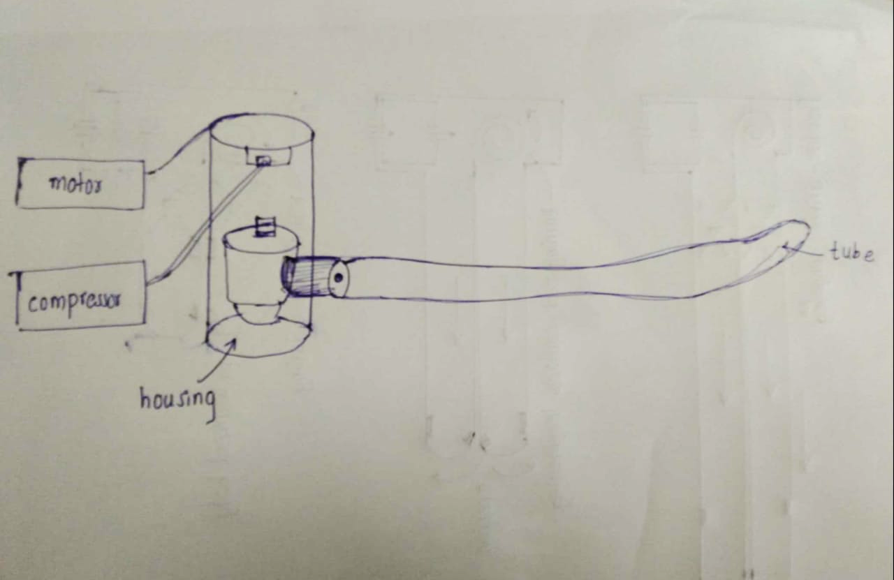
Basic Diagram:

Slide 13
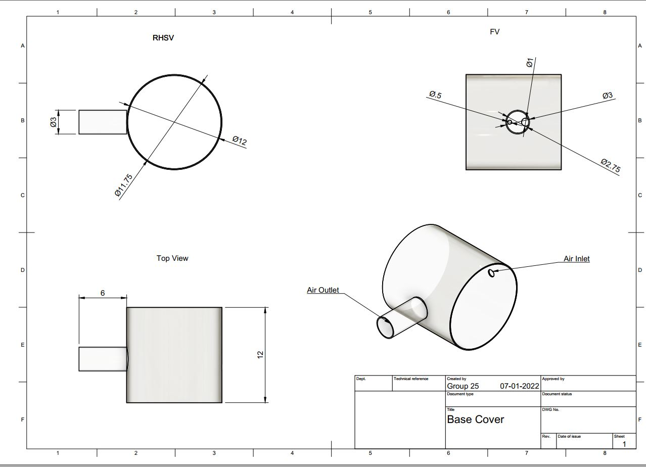
Base Cover
Design

Slide 14
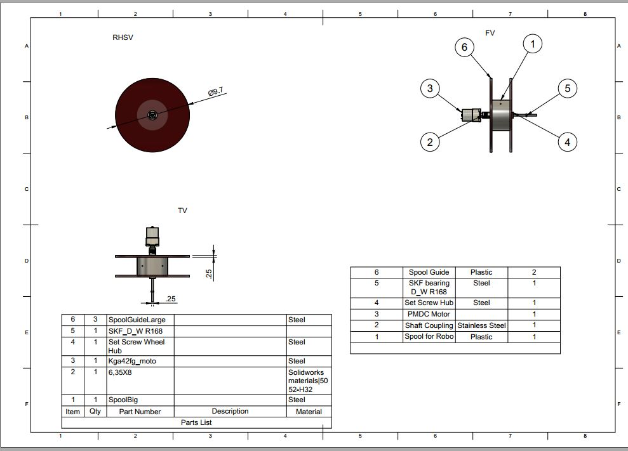
Base
Components

Slide 15
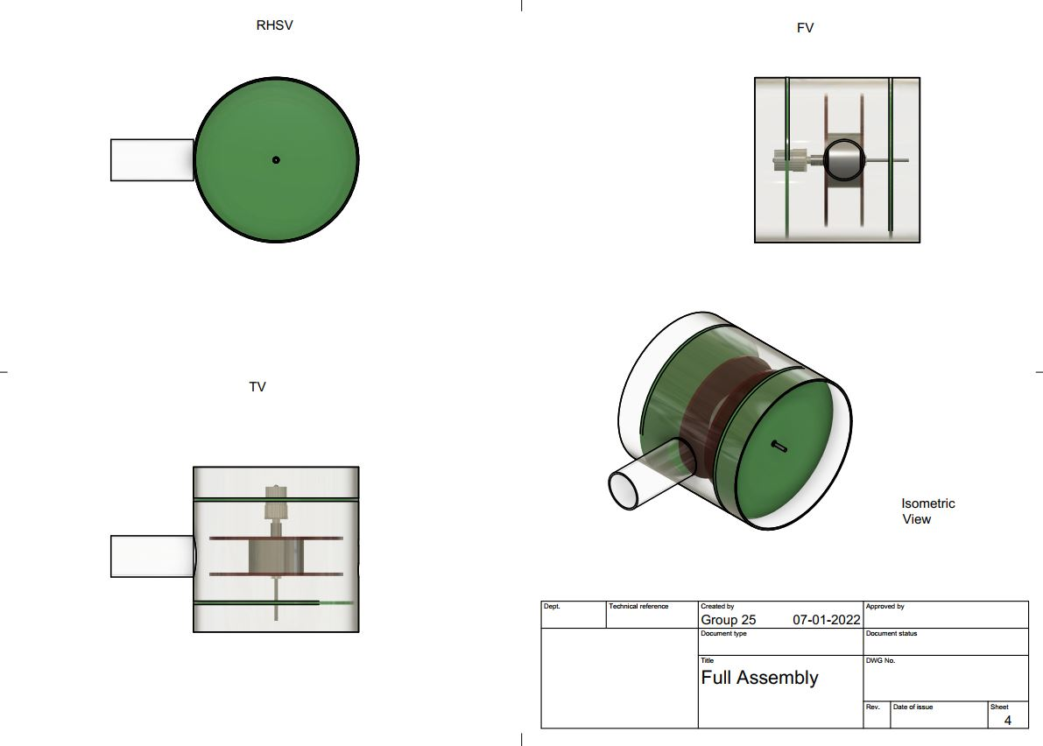
Full base

Slide 16
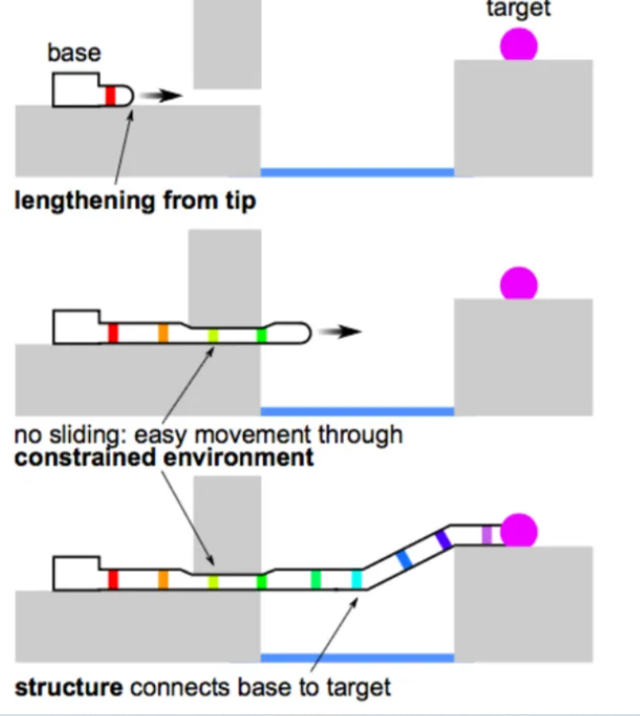
Working:

Slide 17
Growth and Eversion:
Vine robot growth is primarily pressure-driven. This means that pressure enables the turning inside-out of the plastic by “pushing” material out during actuation.
Eversion refers to the process of turning the tubular roll of plastic — the body of the vine robot — inside-out as the robot grows.
The unused material is stored in a spool within the base station.
Enough pressure is created and the inverted tubing will inflate to form a cylinder.
The pressure is increased and the robot will begin lengthening as the spool unwinds and material everts, or turns inside out.
In models that include robot retraction, the spool is motorized to rewind material into the spool but may also be used to restrict growth to a particular rate.

Slide 18
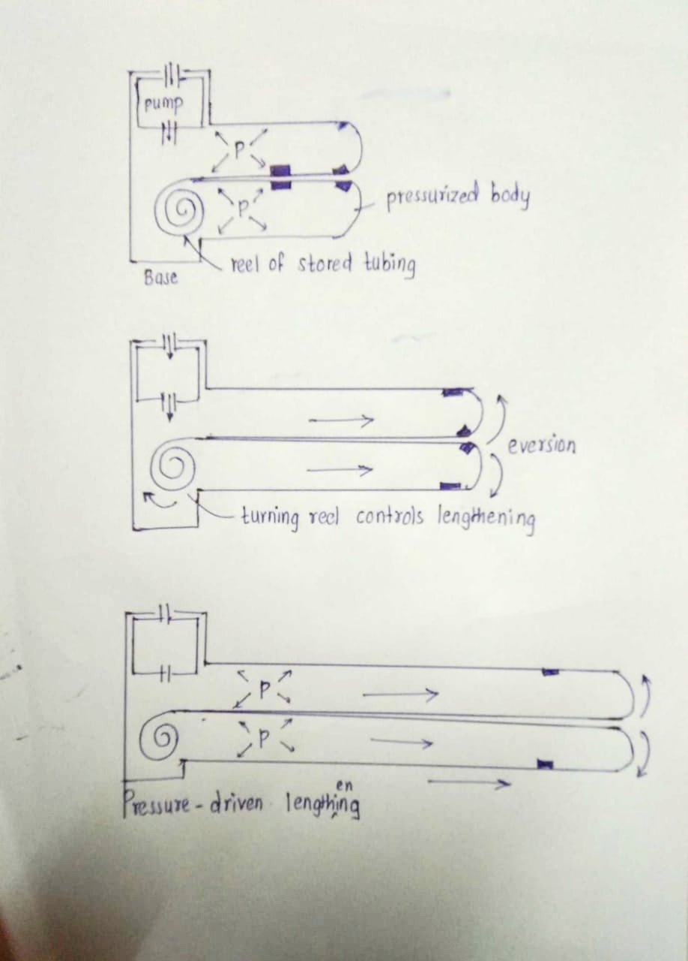

Slide 19
Specifications of Vine Robots:
Compressor: For providing pressure to the tube at a required level. Pressure level varies according to the application.
Motor: Source of electrical energy.
Tube Material: Thermoplastic Polyurethane coated nylon fabric was chosen, as these fabrics have good air holding capacity for extended periods of time
Rollers in case of retracting
Housing:The housing provides the soft robot a place to reside before deployment, mounting it at a specific location and orientation on the user.
Actuators:
Responsible for moving and controlling a mechanism or system.

Slide 20
Before launching, variables under our control include:
Robot Diameter
Angle of Approach
Turn Locations
Turn Angles
During operation, variables under our control include:
Growth Rate: The rate at which the robot starts growing and moving towards desired location/ destination.
Retraction Rate: After fulfilling the desired target, the rate at which the recoiling of the robot takes place.
Robot Stiffness (pressure and motor dependent)

Slide 21
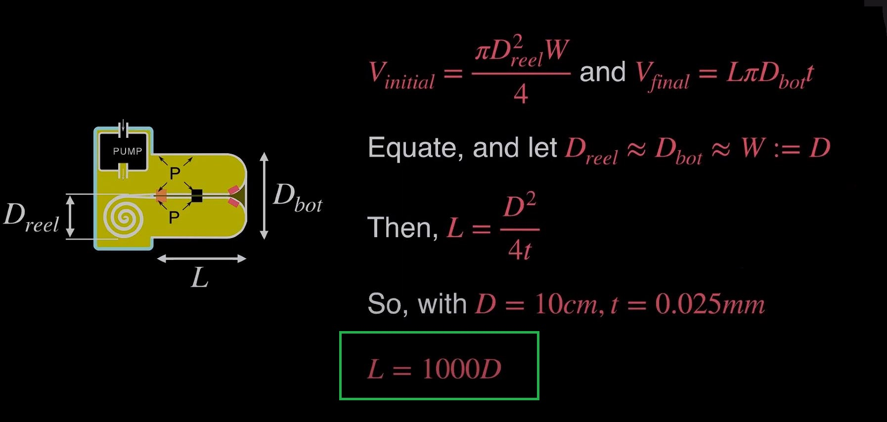
Length Scaling

Slide 22
1. Pneumatically everting vine robot: The basic requirement is that the design should have the soft robot body be made of a non stretchable material that is flexible enough to be turned inside out at the tip and that is capable of containing pressurized air.
2. Teleoperation: Our system is also teleoperated to allow the human operator to make decisions about how to proceed with navigation and rescue in unstructured environments. To achieve effective teleoperation, the robot’s growth and steering must be controllable, and there must be an interface for the human operator to give control inputs. There must also be a way for the human operator to observe the position of the robot tip within its environment
DESIGN REQUIREMENTS

Slide 23
3. Navigation and Rescue: Our system is be capable of navigation and rescue tasks, which means it must be able to grow to a length useful for navigation and rescue , pass through small apertures, and support its own body weight when navigating vertically and over gaps in the floor of the environment.
4.Usability in the field:Finally, our system is usable in the field, which means that it must be portable, mechanically and electrically robust enough to last through its particular mission of rescue and search; able to move fast enough to be practically useful.

Slide 24
Design requirements and solutions for vine robot system
REQUIREMENT | SOLUTION TO RESCUE & SEARCH
Flexible, not stretchable, airtight soft robot body material | Thin, airtight fabric
Controllable growth | Antagonistic growth control with motor and pressure regulator
Controllable steering | Series pouch motor actuators controlled by pressure regulators
Human operator control interface | Flexible joystick
Human operator situational awareness | Camera at robot tip and display with real-time video feedback
Length | Soft robot body material stored on reel in robot bas
Aperture navigation | Smooth, rounded camera cap; aperture width equals body diameter

Slide 25
Body support | Lightweight body material
Portability | Small soft robot body diameter to ensure portable air compressor can fill i
Mechanical robustness | Durable fabric soft robot body
Electrical robustness | All electronics run off line power; all signals wired
Speed of movement | Fast pressure control, backdrivable motor
Data recording | Camera at robot tip with video recording

Slide 26
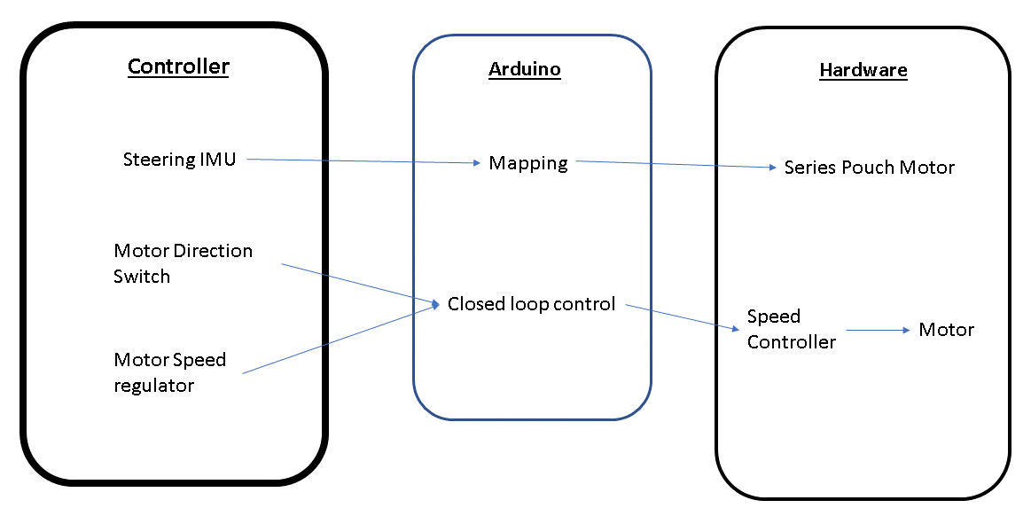

Slide 27
Robot base: A cylindrical pressure vessel made by enclosing large cylinder with end caps to prevent leakage.It is used to store the undeployed robot body material on a spool
Smaller cylinder is fixed inside a hole in the large cylinder using hot glue, and the base of the main body tube of the vine robot is clamped to this smaller cylinder to create an airtight seal.
To allow the robot body to grow to full length and still be pulled back after deployment, the distal end of the main body tube is attached to a string the length of the robot body.

Slide 28
4.The string is tied to the spool in the base. The spool is driven by a motor with an encoder which allows controlled release of the robot body material during growth and assists with retraction of the robot body material back into the base.
5.In addition to the robot base, the base station includes pressure regulators, control circuitry, an air compressor, and a solenoid valve. Control of the air pressure in the four tubes of the robot body is achieved using four closed-loop pressure regulators.
6.An Arduino Uno , signal-conditioning circuitry, and a motor driver control the voltages sent to the motor and pressure regulators. A portable air compressor provides a continuous supply of compressed air to the system.

Slide 29
Camera Mount Design
In a rescue operation such as a building collapse- surrounding environment is unfamiliar, thus a camera sending live video is used for feedback and navigation.
A rigid plastic cap is used at the tip of the robot for mounting camera.
Single wide angle camera is used which can provide a wide angle view (120) without any movement requirement.
Camera is powered and transmits data through cable coiled up at robot base which is pulled as the robot extends.

Slide 30
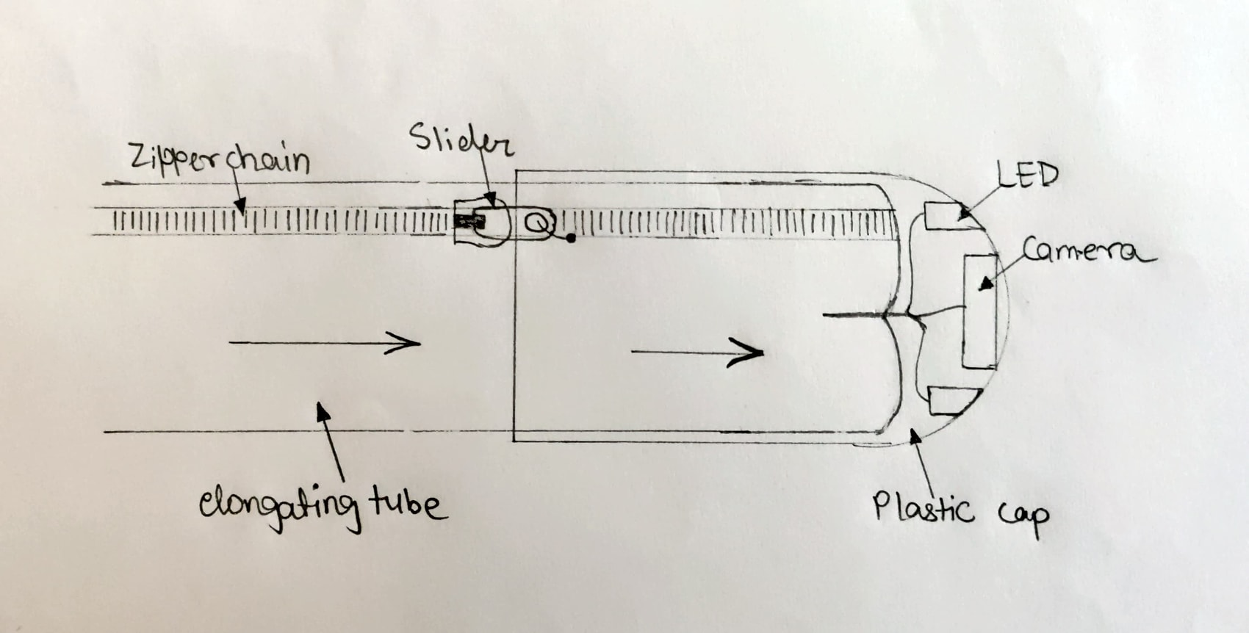
A rigid hemispherical shaped plastic cap is used in which holes/ cutouts can be made to mount a camera and fix small LEDs.
At two diametrically opposite ends of this cap, holes can be punched through which the cap can be tied to the zipper.
The zipper chain is a part of the elongating tube and is placed along its length.
As the pressure in the expanding material increases, it rolls outward and pushes the plastic cap.
The elastic cap moves forward without falling off as it is held to the expanding tube due to two sliders on the chain.

Slide 31
Additional configurations
Multiple hemispherical caps can be designed each having minor configuration differences.
Camera and LEDs
Gripper
Position and ultrasonic sensor
Radar sensor
Temperature and Light sensors

Slide 32
Material of Robot
Low Density Polyethylene was chosen.
This material has good resistance to grease, oil, numerous solvents and impact which will prove to be a plus in rescue operations.
Lastly, the material is lightweight and can support its own weight thus allowing vertical growth,
The material is easy to fabricate and form.
It is cheap in cost for prototyping

Slide 33
Material Overview
Thermoplastics
Materials such as LDPE and TPU are lightweight, inert. TPU has a higher elastic strain limit (50%)compared to LDPE (5%). Thus, LDPE fatigues easily hence failing after moderate number of eversions. LDPE is available in rolls of pre-shaped tubes. Desired length of the body can be unrolled and heat sealed.
TPU on the other hand is available only as film. The materials needs to be made into a tube first through heat sealing. TPU has high wear and abrasion resistance along with resists against oils and grease.

Slide 34
TPU coated nylon
TPU alone can fatigue easily. Thermoplastic coated fabric like TPU nylon improves the durability of the robot body. Fabric prevents propagation of holes thus allowing operation even with punctures. This is a particularly important aspect as in search and rescue operations, the robot’s surrounding may create holes in it, however, continued operation is essential.
Uncoated Fabric:
These are not airtight. Hence can’t be used alone. Combined with a thermoplastic, they can enhance the structural strength of the robot.

Slide 35
Material selection
Following materials were chosen for simulation:
Low Density Polyethylene(LDPE)
Polyethylene terephthalate(PET)
Nylon
Thermoplastic Polyurethane coated Nylon (TPU nylon)
TPU Coated Nylon is chosen based on results obtained through MatLab Simulation.

Slide 36
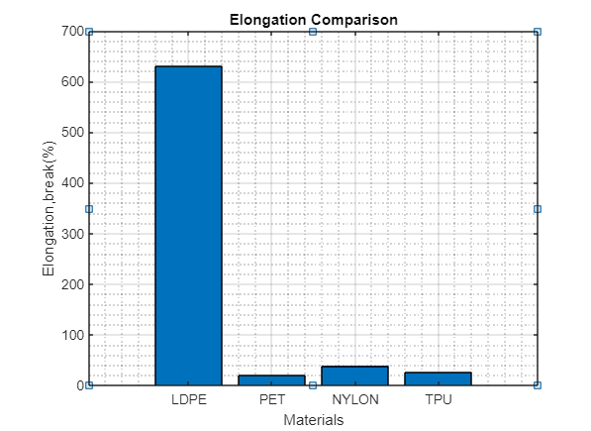
Elongation Comparison

Slide 37
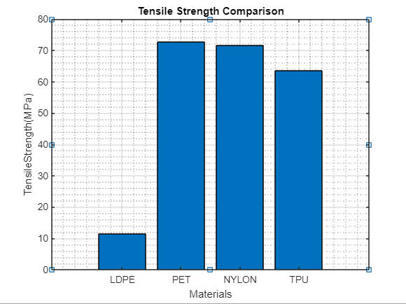
Tensile Strength Comparison

Slide 38
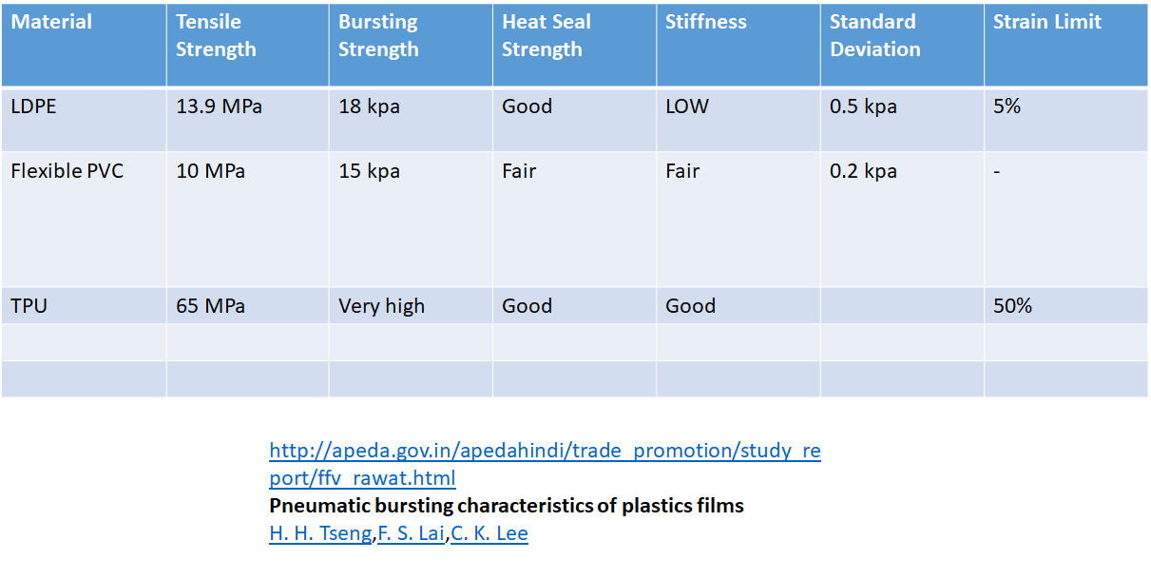

Slide 39
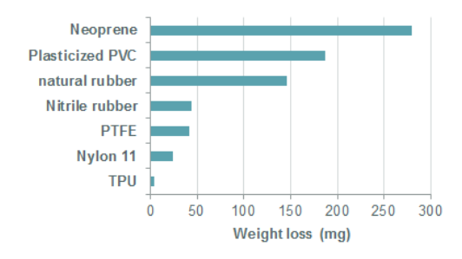
The abrasion resistance of materials is usually determined by measuring the weight loss of a specimen in a standardized wear test as shown in the chart.
It is evident that TPU shows superior abrasion resistance when compared to other materials.

Slide 40
ANSYS comparison of Materials

Slide 41
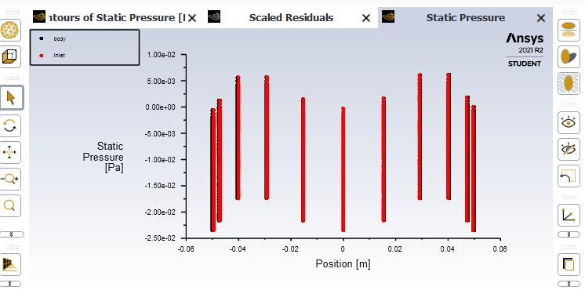
Pressure vs Position for PET

Slide 42
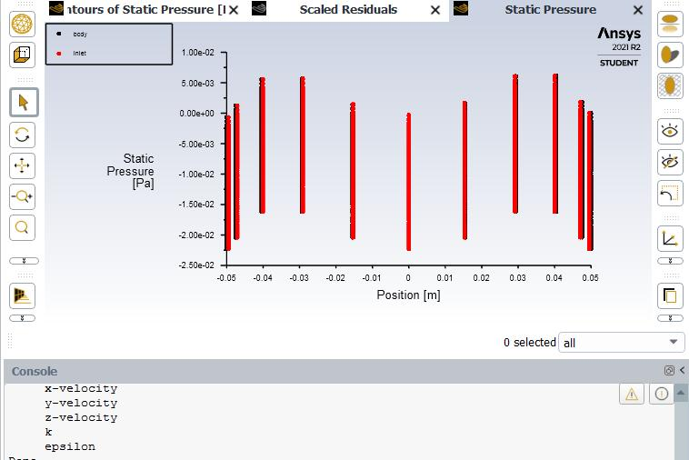
Pressure vs Position for LDPE

Slide 43
Pressure vs Position for PET
This is the plot of static pressure vs position of the tube for ldpe and PET. It is observed that there is large variation of pressure for PET than ldpe. For ldpe the static pressure is approximately distributed. So ldpe is more preferable compared with PET.

Slide 44
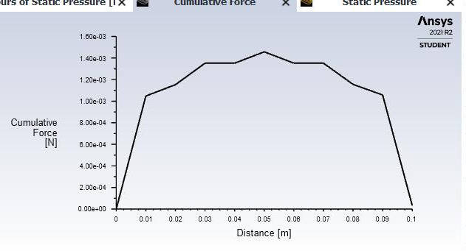
Force Analysis

Slide 45
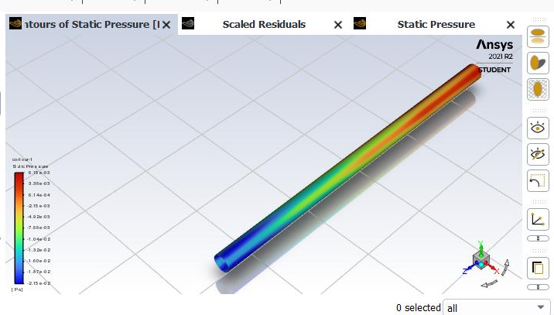
Contour for PET material

Slide 46
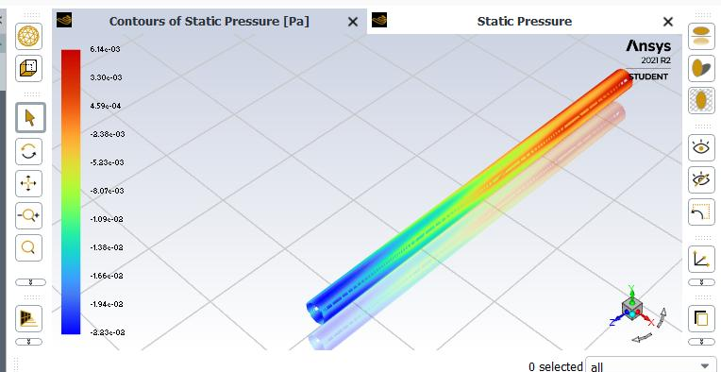
Contour for LDPE

Slide 47
Contour comparison result
From the two contour analysis, it is observed that pressure loss is more in PET than compared to LDPE. Thus, LDPE is the better material for smaller pressure ranges

Slide 48
Robot Calculations :
Diameter of the main body: 10.16 cm
Length of main body: 2 m
Maximum extension speed: 4 cm/s.
Maximum extension pressure: 20 KPa
Material thickness : 0.0005 cm

Slide 49
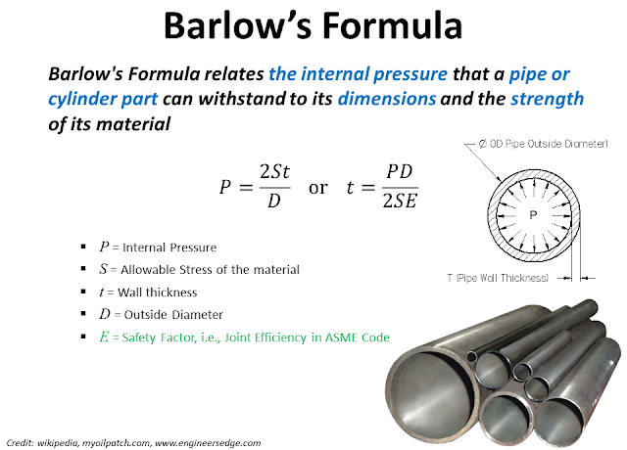
Strength Calculations

Slide 50
Tensile Strength, Yield of LDPE ( at room temp) = 8.48 - 26.2 MPa
Average value: 12.7 MPa Grade Count:27 http://www.matweb.com/search/datasheet_print.aspx?matguid=b34a78d271064c4f85f28a9ffaf94045
Bursting Pressure ( Pmax) = 2St/D Where S=tensile strength of the material
= 2x12.7x10^6 x 50 x 10^-6x100 /(4x2.54)=125000 Pa
= 125 Kpa
= 18.13 psi
Our working range = 2-3 psi
Factor of Safety for failure due to bursting = 6-9

Slide 51
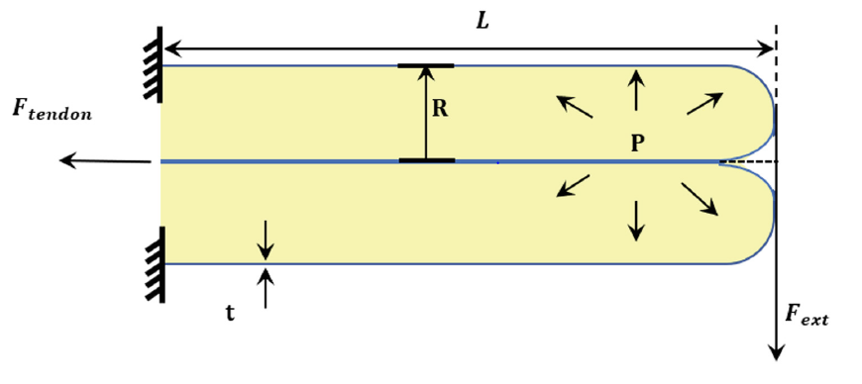
Load Bearing Capacity
From [16]
F_{collapse} = πR³P/L
L = πR³P/F_{collapse}
L = (3.14x0.1016³x20684.3)/(0.25x9.81)
L = 27.788 m
That means for the length beyond 27.788m the robot would collapse
with the force of 2.4525N (weight of the cap).
For safe side, our proposed length considered is 2 m.

Slide 52
For L = 2m
F_{collapse} = πR³P/L
F_{collapse} = (3.14x0.1016³x20684.3)/2
F_{collapse} = 34.075N
Taking factor of safety as 2,
Collapse force would be coming out as = 34.075/2
F load = 17.0375 N

Slide 53
Velocity = Flow rate/area = 0.000366666/0.0081073 = 0.0452 m/sec
= 4.5 cm/sec
Approx time to expand = 200/4.5 = 40 seconds

Slide 54
Steering Mechanism
Steering of the robot will mainly be of two types:
Passive Steering 2)Active Steering

Slide 55
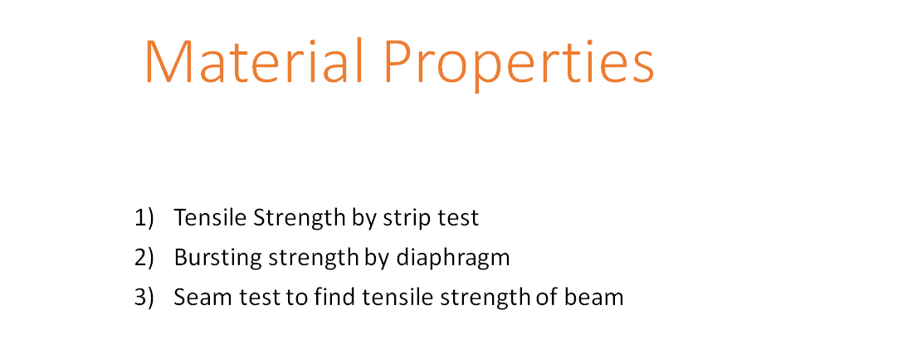

Slide 56
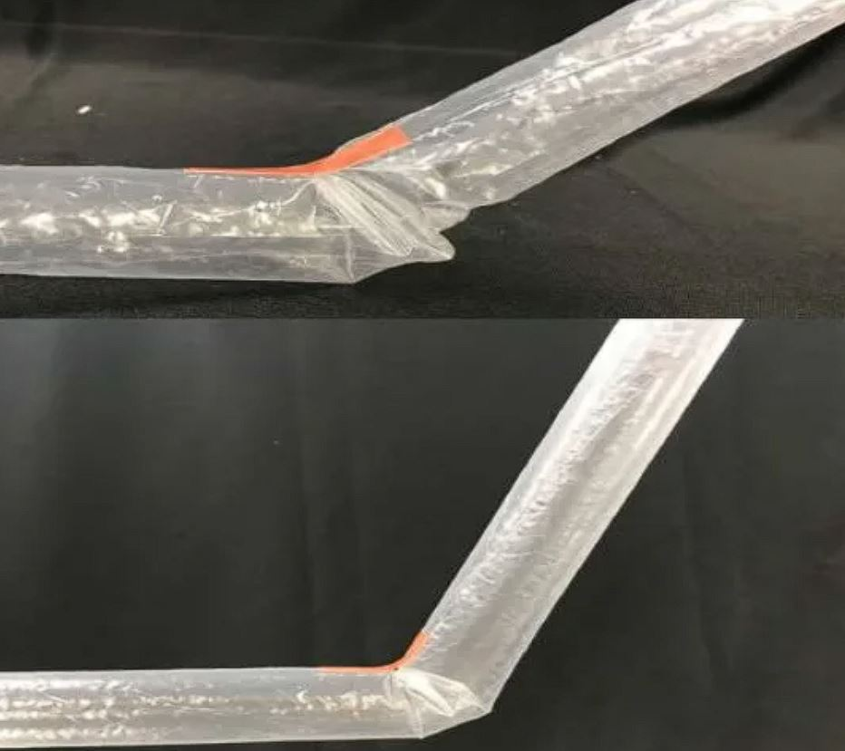
Pre-forming using tape

Slide 57
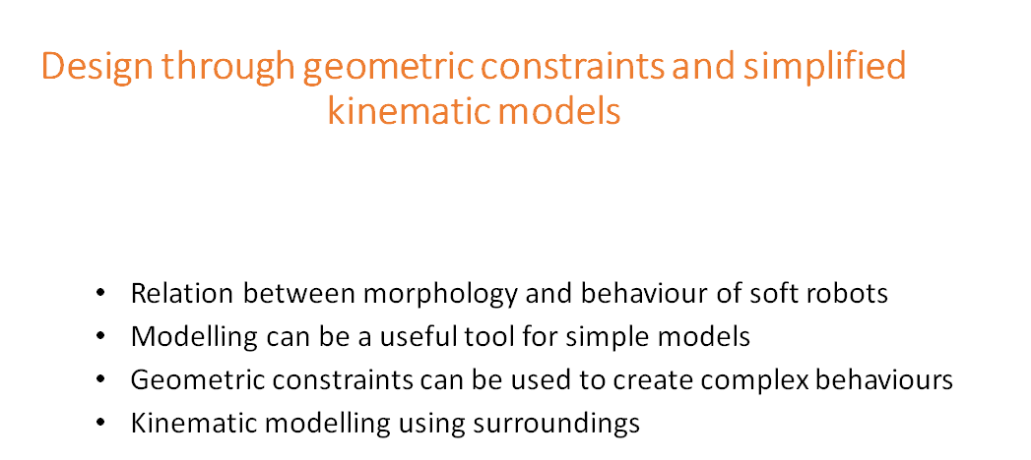

Slide 58
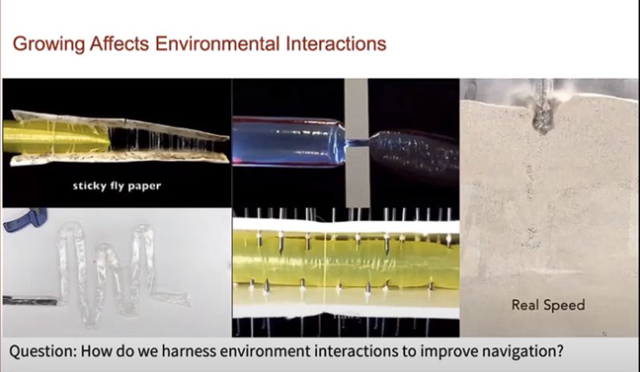

Slide 59
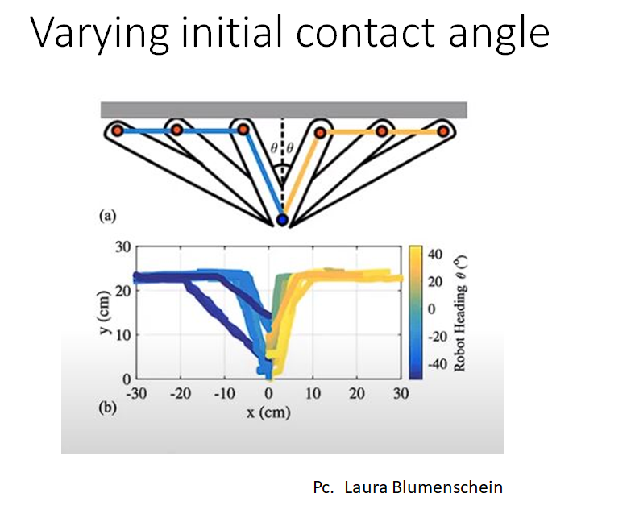

Slide 60
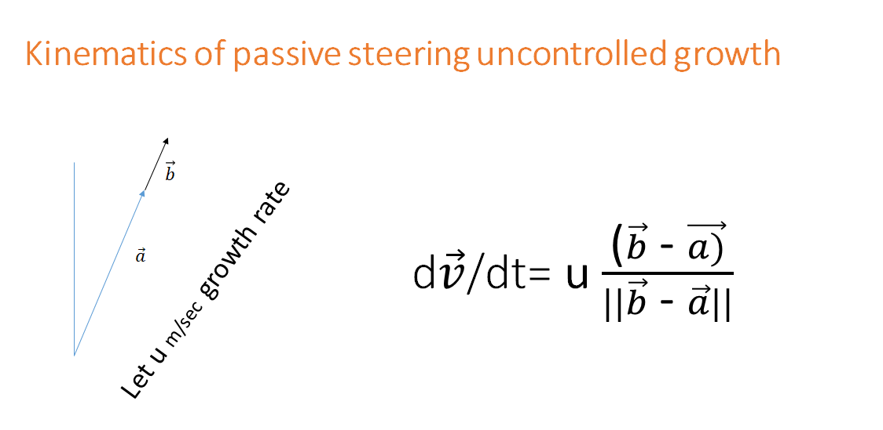

Slide 61
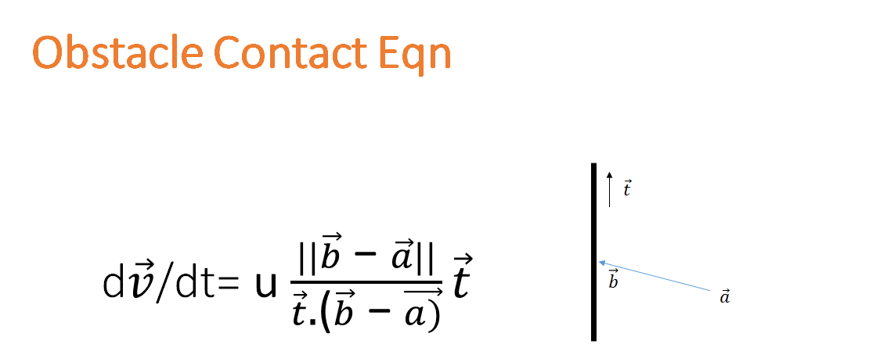

Slide 62
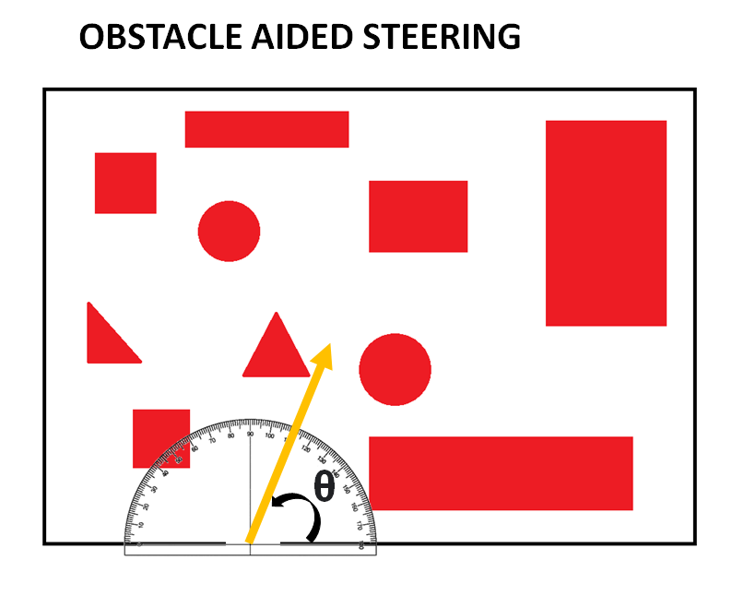

Slide 63
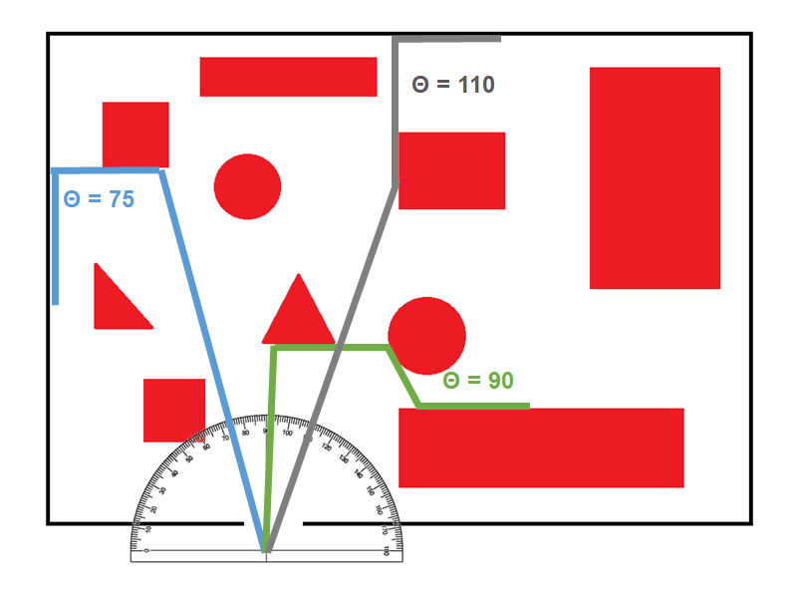

Slide 64
Active Steering
SPM ( SERIES POUCH MOTORS)

Slide 65
The three series pouch motors can be attached lengthwise to the exterior of the main body using double-sided tape, equally spaced around the circumference of the main body tube.
SPM- 1
120°
SPM-2
SPM-3

Slide 66
contracts
inflated
When one of the series pouch motors is pressurized, the length change that it produces causes the entire robot to curve in the direction of that actuator.
`

Slide 67
The actuator tube diameters that we will choose will be as large as possible while allowing a small gap between neighboring actuators.
The three shortening actuators move the robot tip in two degrees of freedom (DoF) on a surface in 3D space.
The third DoF of robot tip motion is produced through growth. Growth and steering can occur simultaneously.
Y
X

Slide 68
Steering Control Circuit
Air flow from compressor
Robot Tip
Controller/Joystick
Filter 1
SPM 1 regulator
Steering signals
IMU
Arduino ( mapping)
Filter 2
SPM 2 regulator
Display
Filter 3
SPM 3 regulator
Camera
Video processing software

Slide 69
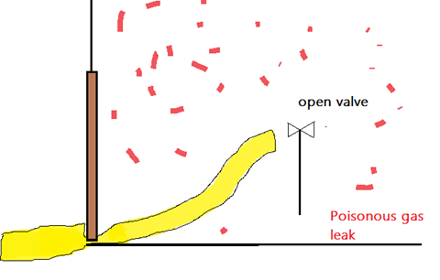
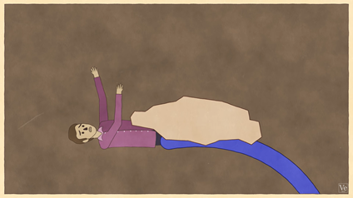
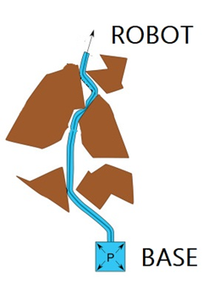
Applications in S&R

Slide 70
Future Work :
Development of Basic Model Robot Prototype
Active Steering
Mathematical and Kinematic Analysis of Robot Movement in 2D
Work on Retraction of the Robot

Slide 71
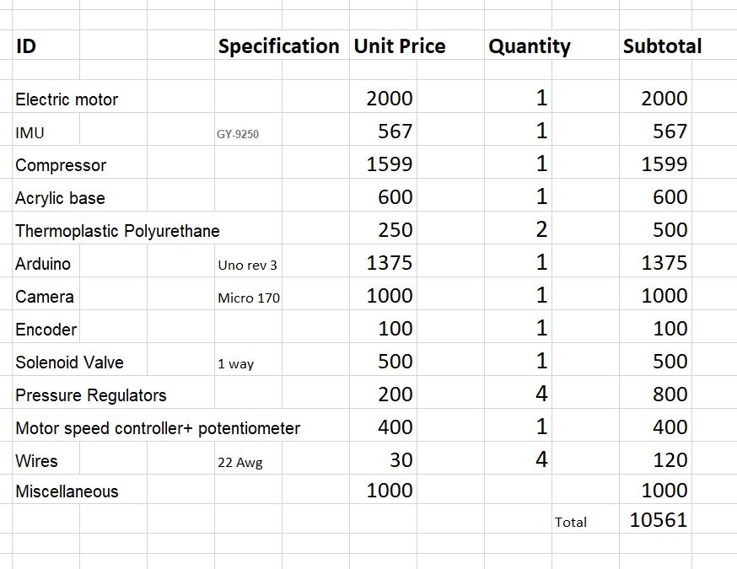
Costing and Bill of Materials

Slide 72
Laura H. Blumenschein,1,* Margaret M. Coad,2 David A. Haggerty,3 Allison M. Okamura,2 and Elliot W. Hawkes3 2019
Design, Modelling,Control and Applications of everting Vine Robots
In nature, tip-localized growth allows navigation in tightly confined environments and creation of structures. Recently, this form of movement has been artificially realized through pressure-driven eversion of flexible, thin-walled tubes. In this review recent work on robots that “grow” via pressure-driven eversion, referred to as “everting vine robots,” due to a movement pattern that is similar to that of natural vines. Work is divided into four categories. First, the design of everting vine robots, highlighting tradeoffs in material selection, actuation methods, and placement of sensors and tools is examined. These tradeoffs have led to application-specific implementations. Second, the state of and need for modeling everting vine robots is described. Quasi-static models of growth and retraction and kinematic and force-balance models of steering and environment interaction have been developed that use simplifying assumptions and limit the involved degrees of freedom.
2.Seref Kemal Talas 1, Bora Alp Baydere 1, Timur Altinsoy 1, Cem Tutcu 1, Evren Samur 1 2020
Design and Development of a Growing Pneumatic Soft Robot
Soft continuum robots are getting more popular in areas such as minimally invasive surgery, search and rescue, and inspection due to their inherent compliance and flexibility. However, most of the conventional continuum robots still lack the ability to significantly change size and length. In this study, a growing pneumatic soft robot made up of pressurized thin-walled tubings that can move in three-dimensional space with an extension ratio only limited by manufacturing capabilities is introduced. Besides the ability to grow from the tip, this design provides active steering by controlling the speed of each tubing separately, controllable stiffness that can be changed during motion, and capability to carry a tool channel.

Slide 73
3.Hawkes, Elliot W.; Blumenschein, Laura H.; Greer, Joseph D.; Okamura, Allison M. (2017)
A soft robot that navigates its environment through growth
Growth is an intriguing method for navigating the environment and is found across kingdoms and scales in nature. Although limited in range, it allows access to constrained environments and enables the creation of 3D structures along the path of movement. Here in this paper, basic versions of these capabilities are presented in a class of pressure-driven soft robots and robot bodies that range across two orders of magnitude in diameter. This type of robot body can lengthen by thousands of percent from its tip, and its peak rate of extension is comparable to that of animal or robot locomotion. Further, demonstration of active control of direction with onboard sensing, enabling response to an environmental stimulus is carried out. Results help pave the way for engineered systems to exploit growth as a paradigm for navigating constrained environments while forming potentially useful 3D structures.
4.By Margaret M. Coad, Laura H. Blumenschein, Sadie Cutler, Javier A. Reyna Zepeda, Nicholas D. Naclerio, Haitham El-Hussieny, Usman Mehmood, Jee-Hwan Ryu, Elliot W. Hawkes, and Allison M. Okamura(2019)
Design, Teleoperation, and Deployment for Navigation and Exploration of Vine robots
With the design of robust, field-ready vine robots, the aim is to improve the state of the art for robots that can nondestructively explore small spaces. Continued research into burrowing with pneumatically everting vine robots could open doors to navigation in even more restricted spaces than is currently possible. Additionally, using the vine robot’s body as a conduit to pass material through it could take advantage of its unique mechanism of movement through growth. Another goal of this project is to make the design of vine robots accessible for other researchers and end users. In this article, a complete vine robot system for use in the field for navigation and exploration tasks, and deployment of two slightly different versions of this system is done.

Slide 74
5. Laura H. Blumenschein,1,* Margaret M. Coad,2 David A. Haggerty,3 Allison M. Okamura,2 and Elliot W. Hawkes3 (2020)
Design, Modeling, Control and application of everting vine robots.
This project takes its inspiration from the growth of roots of plants and cells in constrained environments. Two categories of materials can be used- coated fabrics like Thermoplastics such as LDPE and Uncoated fabrics such as ballistic nylon.Four steering mechanisms have been discussed which include using pneumatic actuators distributed along the length or concentrated at certain points, tip localised steering and preformed steering shapes. Two growth mechanisms have been discussed: first being pressure driven growth and use of motor for retraction second being maintaining a constant pressure in the robot and unwinding material from the spool using a motor.
6. Joseph D. Greer1, Laura H. Blumenschein1, Allison M. Okamura1, and Elliot W. Hawkes2 (2018)
Obstacle-Aided Navigation of a Soft Growing Robot
This research focuses on how obstacles in path of the robot can help it navigate though unknown environment. Here, a kinematic interaction model describes that when the bending moment on the body (due to an obstacle) is larger than the air pressure in the tube, buckling of the tube takes place, causing the robot to move tangent to the obstacles surface. This contact point determines further trajectory of the robot. A computational algorithm is developed which takes initial position and desired length as inputs and gives the location of the tip at the final length. The experimental results and outcomes predicted by the algorithm match in many cases with minor variations. (Traveling through cluttered environment, circular object, hole in a wall)

Slide 75
7. Jamie Luong , Paul Glick, Aaron Ong , Maya S. deVries , Stuart Sandin , Elliot W. Hawkes , Michael T. Tolley “Eversion and Retraction of a Soft Robot Towards the Exploration of Coral Reefs” (2019)
This project involves building an eversion robot capable of being driven underwater in congested spaces for coral exploration. The robot is pressurised with water to maintain neutral buoyancy. A stepper motor unspools fabric at the base. Silicone coated ripstop nylon is used as material of the tube. Water is pressurised using a submersible pump.

Slide 76
[8] A Soft, Steerable Continuum Robot that Grows via Tip Extension:
Joseph D. Greer, Tania K. Morimoto, Allison M. Okamura, and Elliot W. Hawkes
This paper presents full design and mathematical modelling of a soft robot system. sPAMs are used for steering
The kinematic model has a mean position accuracy of 5.5 cm for predicting the tip position of a 42 cm long robot. It used visual servo control loop for controlling steering. A jacobian model is used for calculations
[9] Soft Eversion Robots in Application of Minimally Invasive Subsurface Drip Irrigation
This project intends to incentivize a transition towards subsurface drip irrigation by providing a less invasive and less expensive method for its installation. It combines a worm-like, soft robot and a pneumatic auger drill to create a robot that can dig and grow underground without the need for soil

Slide 77
[10] Eversion and retraction of a soft robot towards the exploration of coral reefs Coad et al (2020)
To achieve retraction of the robot body, a force must be exerted on the tail to pull it toward the base while a moderate level of pressure is maintained in the body. This paper has implemented everting vine robot versions where a motor drives the reel in the base, allowing not only control of the material release for growth but also reeling in the material for retraction
Further in another paper the researchers developed a retraction device (, which sits inside the robot tip and applies the force required to retract the robot body directly to the robot tip, thus making bending or buckling during retraction effectively impossible. When using a retraction device, a motorized reel in the base is still useful to keep slack from building up in the tail and to store the robot body.
[11] Design and Kinematic Modeling of Constant Curvature Continuum Robots: A Review Robert J. Webster and Bryan A. Jones (2010)
A complete mathematical model if presented for constant curvature robots i.e that follow constant curvature model. It cover static as well as dynamic modelling and control of curvature of such robots in depth.

Slide 78
upheaval. The vine robot can be integrated with a water delivery mechanism to irrigate the area efficiently. The presented research project involved designing and constructing this robot

Slide 79
[12] “Pouch Motors: Printable Soft Actuators Integrated with Computational Design” (2015) Ryuma Niiyama, Xu Sun et al.
This paper proposes concept of pouch motors, a new family of printable soft actuators integrated with computational design. The pouch motor consists of one or more inflatable gas-tight bladders made of sheet materials. This printable actuator is designed and fabricated in a planar fashion. It allows both easy prototyping and mass fabrication of affordable robotic systems
This is the system we have used in our paper
[13]A Tip Mount for Transporting Sensors and Tools using Soft Growing Robots(2019) Sang-Goo, Margaret M. Coad, Laura H et al.
One major Challenge in soft robots is the retraction part. retraction of the report is accompanied by buckling of the entire upper body which is to be overcome using the correct retraction design
1. String mount: String is attached from the mount to the base of the spool and so as the spool rotates and material expands, the string lengthens.
Advantage: string being physically attached to the spool helps in stronger pull forces during retraction.
2. Cap with a small motorized reel in it: A motor is the real to which a string is rolled up is present in the cap and the string through the inside of the expanding due is attached to the base.

Slide 80
While expansion, the reel slowly unrolls string for the body to grow and simultaneously keeping the tip on the body.
Problem: a) Buckling of robot body during retraction still exists because the base is the driving force in pulling the string back.
b) Is the length of the robot increases the reel inside the mount also increases in size and so the cap size limits the robot length.
3. magnetic rings mount:
A Magnetic ring on the inside of the report and an outer ring on the cap these two rollers are attach magnetically and can accommodate a retraction as well as growth of the robot body.
Problem: pulling force in this case is limited to the magnetic force between the two of the mounts.
The research paper comes to conclusion that regardless of the internal pressure and curvature, soft robots will always buckle rather than invert above a certain length when the tail is away from the base.
Proposed tip mount design:Two motors attached to small drive rollers which pull (during growth) and push (retraction) the material to the tip.

Slide 81
[14]Development of a Pneumatically Controlled Expandable Arm for Rescue Searches in Tight Spaces (2015)
Daisuke Mishima, Takeshi Aoki, Shigeo Hirose.
Traditional Air compressor is loud and not portable. Not suitable for rescue ops. They have used a man powered foot pump which inflated the body.
Material selected: Kevlar Fiber lined with urethane rubber
To keep head mount on tip, a wire passes through the tube. Since inside of tube is 2x faster, it causes the wire to build up and thus the mount to fall off. So a wire rewinding device is present in the head unit to secure it tightly to the body.
Used a winch to wind the tube and wire simultaneously.
[15] "Soft Robot Review"(2017)Chiwon Lee, Myungjoon Kim, Yoon Jae Kim, Nhayoung Hong, Seungwan Ryu, H. Jin Kim, and Sungwan Kim
2.1) Actuation;
2.1.1 Variable length tendons: tension cables or SMA actuator embedded in segments of robot.
2.1.2 Fluidic Actuator: Inflates channels within body to deform body in controlled manner. Pressure used here can be pneumatic (preferred) or hydraulic (produces large force)
2.1.3 EAP: polymers that change in shape when stimulated by electric field
(Table 1 summarizes advantage of all 3 approaches)
2.2 Sensing:
Conventional sensors not used due to the bending property of SR. Soft sensors used.

Slide 82
2.3: Structure:Material used is silicone for the body.
2.4 Controlling: Rigid electronic components have limitations in which standing extreme mechanisms which include stretching twisting compressing. However there has been progress in electronics area which use soft electronic systems on a stretchable electronics for soft robotics.
2.5 Material: Silicone or rubber
2.6 Fabrication:Shape deposition manufacturing and Smart composite microstructure and 3-D printing technology used.
Mainly 2 types of controls of soft robots:
1. continuum robots with inverse kinematic algorithms
2. Continuum robots with neural network algorithm.
Conclusion:
This is a study on soft robotics with no specific application for the robot is considered and hence only a brief idea of materials and controlling methods Have been discussed

Slide 83
[16] Payload Capabilities and Operational Limits of Eversion Robots
This research paper has explained the maximum payload capabilities of the robot by taking three failure conditions, failure due to yielding, failure due to buckling and failure due to lateral collapse force.
[17] YanLi He et. al Experiment and Theoretical Analysis Study of ETFE inflatable tubes
The load bearing capacity of an ETFE inflatable tube is tested in this paper and a comparative study of two wrinkling theories, the bifurcation theory and tension field theory is carried out for wrinkling analysis of the ETFE tube. Results obtained by bifurcation theory match with the experimental results validating the theory
[18] Retraction of Soft Growing Robots without Buckling Margaret M. Coad et. al
This proposes a mechanism for retraction of robots without buckling of the inflated robot body. A device roller mechanism is created that helps in the retraction.

Slide 84
References:
https://drive.google.com/file/d/1pkW4W1IyfzrgUAESRJICeCTYc_-g73nD/view
https://www.vinerobots.org/build-one/pre-formed-vine-robot/
https://www.ncbi.nlm.nih.gov/pmc/articles/PMC7805729/
https://stacks.stanford.edu/file/druid:ky237km2272/Margaret_Coad_Dissertation-augmented.pdf
https://www.frontiersin.org/articles/10.3389/frobt.2020.548266/full
https://www.ncbi.nlm.nih.gov/pmc/articles/PMC7805729/
https://pubmed.ncbi.nlm.nih.gov/32150509/
https://www.ncbi.nlm.nih.gov/pubmed/30339050
https://sci-hub.mksa.top/10.1126/scirobotics.aan3028
https://drive.google.com/file/d/1h6fK4for6EJF50jn4STut8br74GpkokW/view?usp=sharing
https://www.researchgate.net/figure/Working-principal-of-the-growing-vine-robot_fig1_346571887
Papers

Slide 85
[1]Laura H. Blumenschein,1,* Margaret M. Coad,2 David A. Haggerty,3 Allison M. Okamura,2 and Elliot W. Hawkes3 2019 “Design, Modelling,Control and Applications of everting Vine Robots “
[2]Seref Kemal Talas 1, Bora Alp Baydere 1, Timur Altinsoy 1, Cem Tutcu 1, Evren Samur 1 2020
“Design and Development of a Growing Pneumatic Soft Robots”
[3] Hawkes, Elliot W.; Blumenschein, Laura H.; Greer, Joseph D.; Okamura, Allison M. (2017)
A soft robot that navigates its environment through growth
[4]Margaret M. Coad, Laura H. Blumenschein, Sadie Cutler, Javier A. Reyna Zepeda, Nicholas D. Naclerio, Haitham El-Hussieny, Usman Mehmood, Jee-Hwan Ryu, Elliot W. Hawkes, and Allison M. Okamura(2019)
Design, Teleoperation, and Deployment for Navigation and Exploration of Vine robots

Slide 86
[5]. Laura H. Blumenschein,1,* Margaret M. Coad,2 David A. Haggerty,3 Allison M. Okamura,2 and Elliot W. Hawkes3 (2020) Design, Modeling, Control and application of everting vine robots.
[6]. Joseph D. Greer1, Laura H. Blumenschein1, Allison M. Okamura1, and Elliot W. Hawkes2 (2018)
Obstacle-Aided Navigation of a Soft Growing Robot
[7] Jamie Luong1∗ , Paul Glick1∗ , Aaron Ong1∗ , Maya S. deVries2 , Stuart Sandin2 , Elliot W. Hawkes3 , Michael T. Tolley1 Eversion and Retraction of a Soft Robot Towards the Exploration of Coral Reefs
[8] A Soft, Steerable Continuum Robot that Grows via Tip Extension:
Joseph D. Greer, Tania K. Morimoto, Allison M. Okamura, and Elliot W. Hawkes

Slide 87
[9]Joseph D. Greer, Tania K. Morimoto, Allison M. Okamura, and Elliot W. Hawkes(2019) : A Soft, Steerable Continuum Robot that Grows via Tip Extension:
[10]Divyanshu Paschia PHD thesis(2020) : Soft Eversion Robots in Application of Minimally Invasive Subsurface Drip Irrigation
[11]Robert J. Webster and Bryan A. Jones (2010) : Design and Kinematic Modeling of Constant Curvature Continuum Robots: A Review ; The International Journal of Robotics Research
[12]Ryuma Niiyama, Xu Sun, Cynthia Sung, Byoungkwon An, Daniela Rus, and Sangbae Kim
Pouch Motors: Printable Soft Actuators Integrated with Computational Design (2015) : MIT open source

Slide 88
[13] A Tip Mount for Transporting Sensors and Tools using Soft Growing Robots
Sang-Goo Jeong, Margaret M. Coad, Laura H. Blumenschein, Ming Luo, Usman Mehmood, Ji Hun Kim, Allison M. Okamura and Jee-Hwan Ryu.
[14] Luong, J., Glick, P., Ong, A., deVries, M. S., Sandin, S., Hawkes, E. W., et al. (2019). “Eversion and retraction of a soft robot towards the exploration of coral reefs,” in IEEE International Conference on Soft Robotics (Seoul)
[15] "Soft Robot Review"Chiwon Lee, Myungjoon Kim, Yoon Jae Kim, Nhayoung Hong, Seungwan Ryu, H. Jin Kim, and Sungwan Kim

Slide 89
[16] Payload Capabilities and Operational Limits of Eversion Robots
[17] YanLi He et. al Experiment and Theoretical Analysis Study of ETFE inflatable tubes
The load bearing capacity of an ETFE inflatable tube is tested in this paper and a comparative
[18] Retraction of Soft Growing Robots without Buckling Margaret M. Coad et. al
.

